Slide 1



Project 3:Quantum Algorithm as a PDE Solver for Computational Fluid Dynamics (CFD)
Abdullah Kazi, Hussein Shiri, Tania Jamshaid
WISER Quantum Project

Slide 2



Project Statement:
Designing resource-lean, quantum-enhanced PDE solvers to tackle the 1-D viscous Burgers’ equation, a fundamental CFD benchmark.
About Project
•Classical CFD struggles at scale – High-fidelity solvers face prohibitive computational demands due to fine grid requirements and stiff non-linear PDEs.
•Burgers’ equation as testbed – Captures key nonlinearity and diffusion dynamics of fluid motion while remaining analytically solvable.
What problem we are addressing?
Scalability limits cut accuracy for complex flow simulations.
Quantum algorithms like QTN and HSE compress fluid states efficiently, promising faster, more compact simulations.
Ask ChatGPT
Why does it matter?
WISER Quantum Project

Slide 3
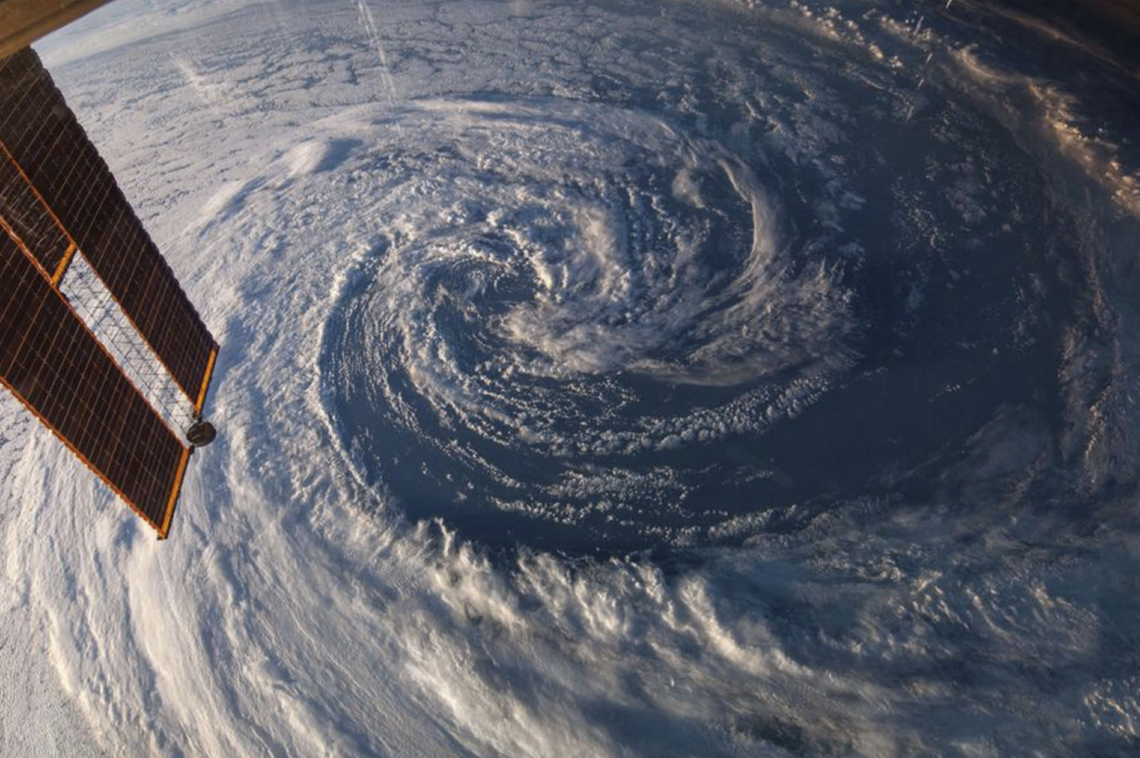
Objectives: Enabling Quantum Breakthroughs in CFD
•
Design quantum algorithms optimized for nonlinear PDEs in fluid dynamics.
Benchmark solvers on Burgers’ equation to capture complex flow behaviors.
Overcome classical computational limits with scalable quantum methods.
Validate solutions rigorously against classical and analytical results.
Integrate quantum solvers into conventional CFD workflows for real-world use.
Pioneer pathways toward quantum advantage in other fields like aerospace and climate simulations.
WISER Quantum Project

Slide 4
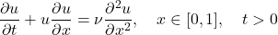
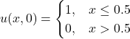
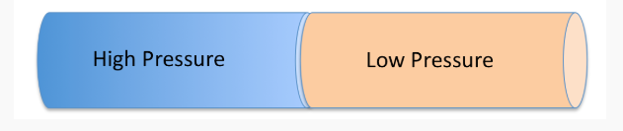
Problem Statement: 1D viscous burger equation
Governing equation:
Wave Phenomena:
A shock wave propagates into the low-velocity region, causing an abrupt change in velocity.
A rarefaction wave moves into the high-velocity region, representing a smooth spreading of the flow.
A contact discontinuity separates the two flow regions, across which velocity and pressure remain continuous.
Initial condition:
Boundary Equation:
WISER Quantum Project
Re3𝐾𝐾 /4

Slide 5




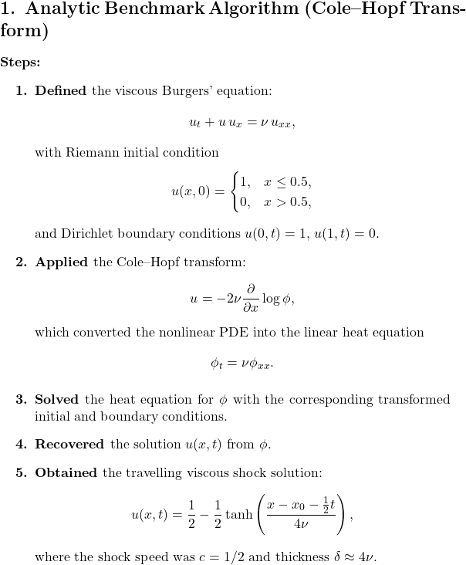
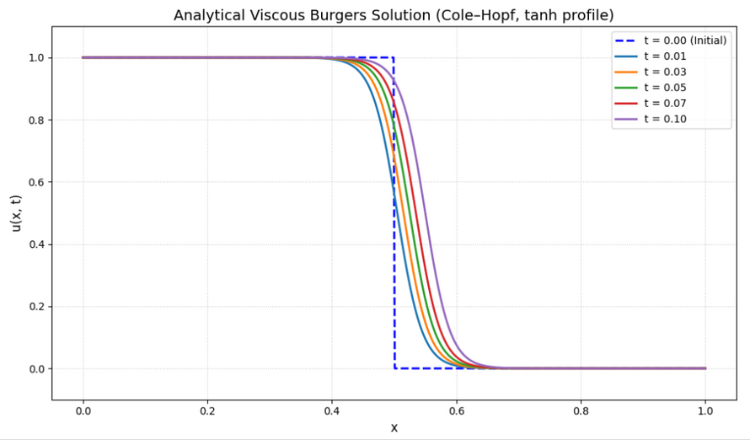
Algorithm Design — Analytic Approach
Analytical solution using Cole–Hopf Transform.
8,
WISER Quantum Project

Slide 6

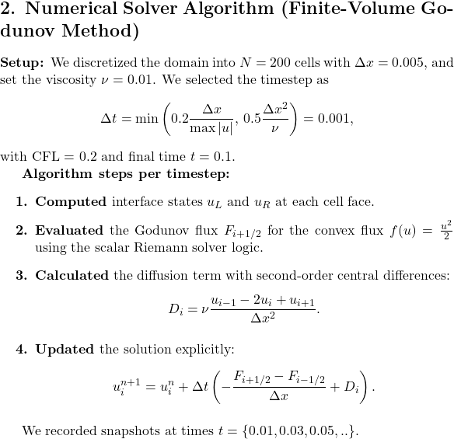
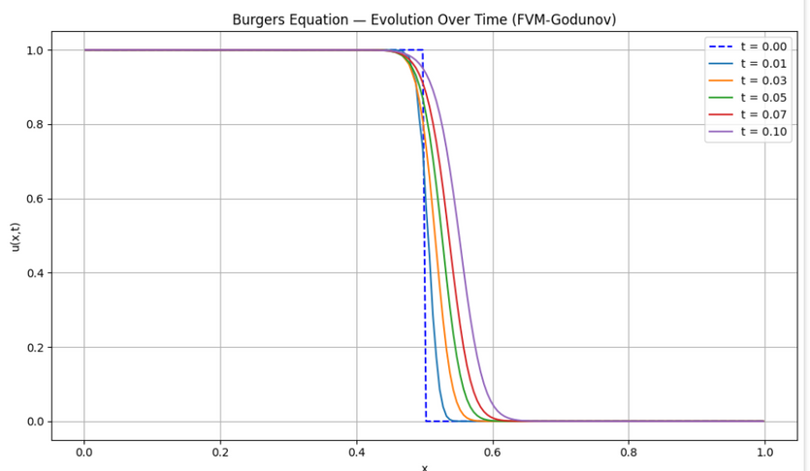
Algorithm Design — Numerical Approach
Numerical solution using FVM-Godunov method
8,
WISER Quantum Project

Slide 7


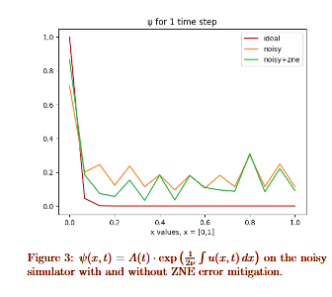
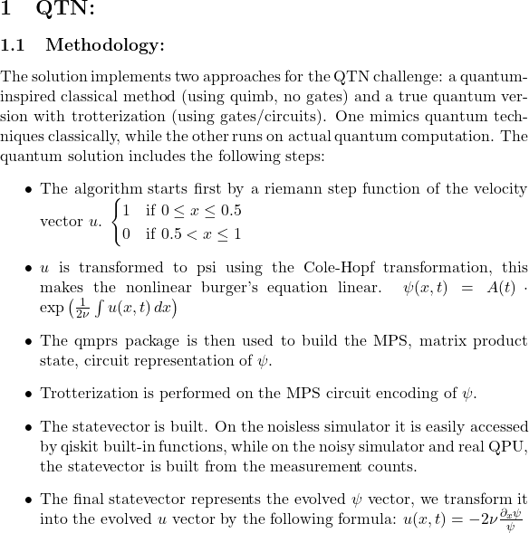
Quantum Tensor Network
•
•
•
WISER Quantum Project

Slide 8
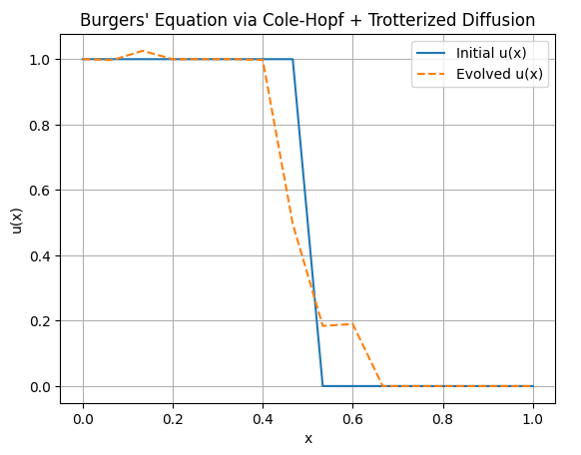
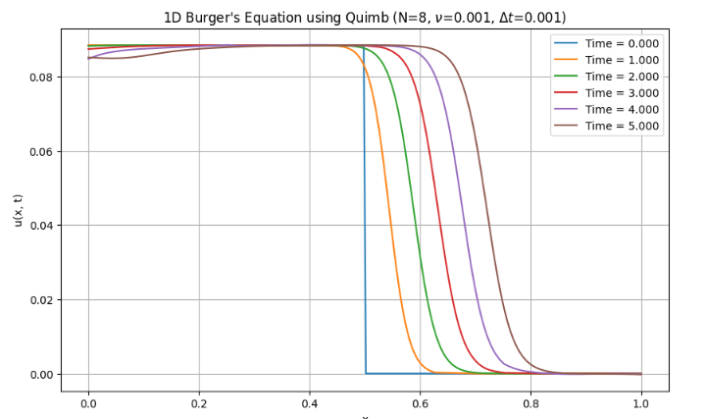
Quantum inspired solution MPS
QTN + Trotterization

Slide 9




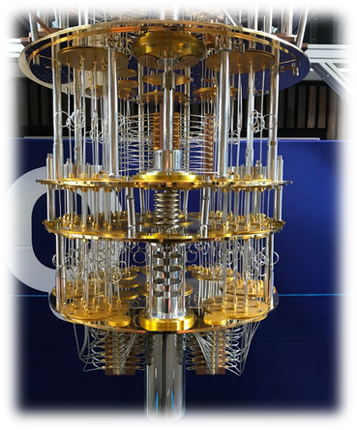
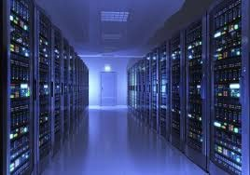
Noiseless vs. Noisy Quantum QTN Results — Key Insights
Noisy Simulation
Noiseless + Scaling
Vs
4-qubit, 1–3 steps, FakeManilaV2 backend.
ZNE: Best (~23% gain at step 1, less after).
DD: No gain, slightly worse.
Noise impact grows with steps.
Classical Best: Godunov FVM (L2=0.288) — slowest (108.8 s).
Worst: Quantum inspired (L2≈174) — fastest (0.03 s).
More qubits → exponential grid & depth growth.
Higher qubits in Trotter → more gates, slower, less accurate.
algorithm
5
WISER Quantum Project

Slide 10


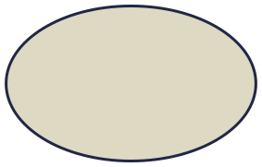





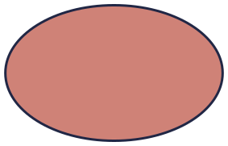
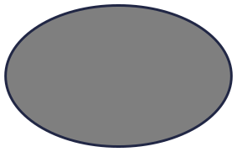
Hydrodynamic Schrödinger Equation (HSE) & QTN Approaches
Quantum trotter
. HSE + Quantum Tensor Networks (QTN)
Hybrid Quantum-Classical
WISER Quantum Project

Slide 11
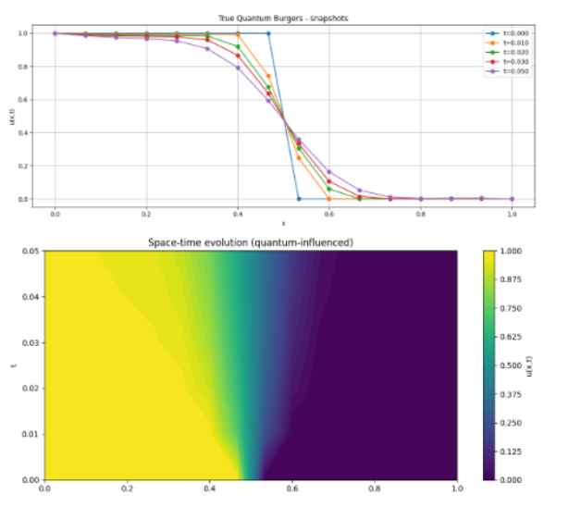
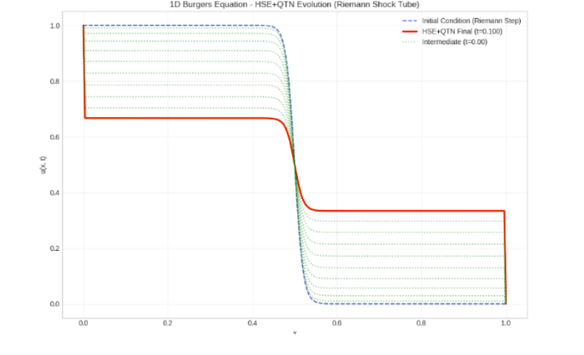
Hydrodynamic Schrodinger equation Method
HSE+QTN: Transforms Burgers’ equation into a quantum wavefunction form, compresses it using tensor networks for efficient simulation of shocks.
Solving Burgers’ equation using a hybrid quantum-classical approach, via quantum circuits and measurement decoding.
WISER Quantum Project

Slide 12
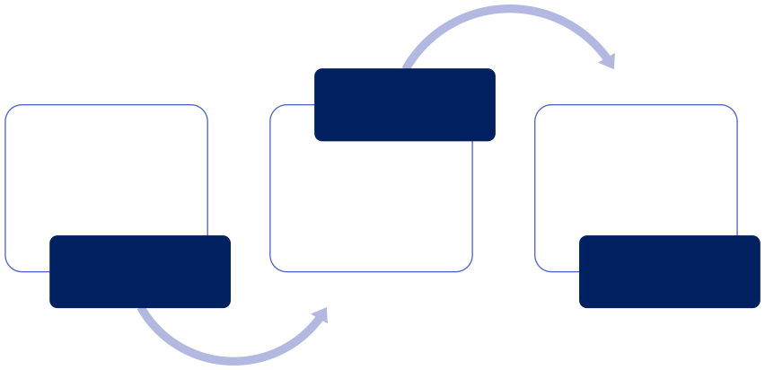
Impact and Future Scope
Q-circuit
•Higher dimensions
Why use quantum ?
•These circuits can easily simulate HSE equations
•Surface codes and error correction
•Exponential decrease in resources
Future Scope
WISER Quantum Project

Slide 13
Related publications
Tushar Pandey, Amir Ali Malekani Nezhad. QMPRS: Quantum Matrix Product Reduced Synthesis, 2025.
DOI: 10.5281/zenodo.15437417.
Johnnie Gray. "quimb: a python library for quantum information and many-body calculations." Journal of Open Source Software, vol. 3, no. 29, 2018, p. 819.
DOI: 10.21105/joss.00819.
IBM. Silicon Quantum Computing announces the world-first integrated circuit manufactured at the atomic scale.
URL: https://qiskit-community.github.io/qiskit-algorithms/tutorials/13_trotterQRTE.html.
R. D. Peddinti et al. "Quantum-inspired framework for computational fluid dynamics." Communications Physics, vol. 7, Article 135, 2024.
DOI: 10.1038/s42005-024-01623-8.
WISER Quantum Project

Slide 14

Thank You
WISER Quantum Project

